Slide 1
Overview of Project and Business Goals
A solution to predict and pick a recipe that will generate high traffic.
A solution that correctly predicts high traffic recipe 80% of the time.
A solution to minimize the chance of showing unpopular recipe.

Slide 2
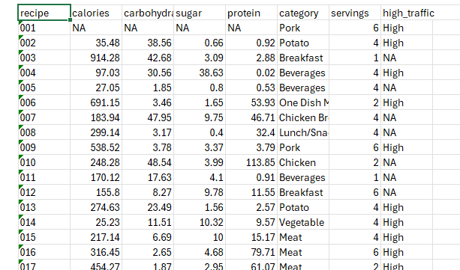
Data
Provided by the product manager

Slide 3
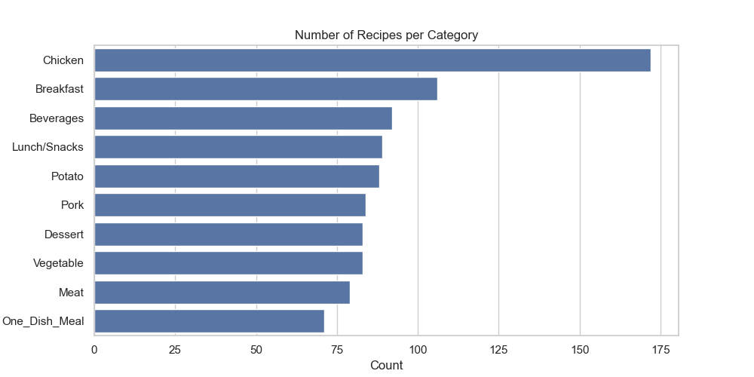
Key findings
There are 10 categories of recipe in this data set.

Slide 4
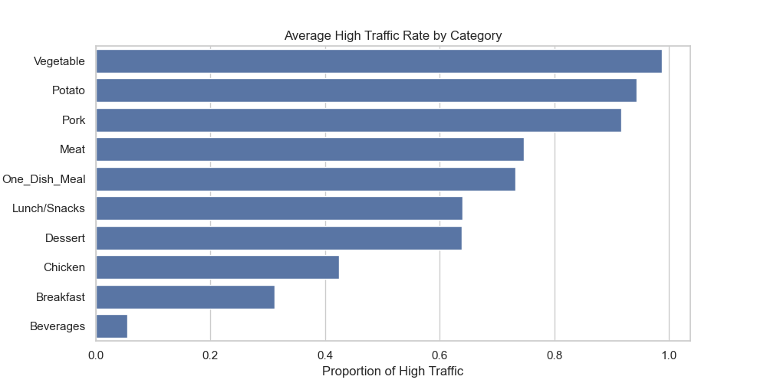
Key findings
Vegetable category ranks highest in average traffic generation despite ranking 8 in the number of times uploaded on the site.

Slide 5
Outcomes
Two models were developed: Logistic Regression model and the Random Forest Classifier.
calories
carbohydrate
Logistic Regression Model
Classification 1
sugar
protein
Random Forest Classifier
Classification 2
category
servings

Slide 6
Outcomes
Three metrics: Precision, Recall and PR AUC (precision recall area under curve)
Metrics | Precision | Recall | PR AUC
Purpose | Correctness | Sensitivity | Discrimination between positive and negative.
Range | 0-1 | 0-1 | 0-1

Slide 7
Outcomes
The Logistic Regression model performed better than the Random Forest Classifier.
Model | Precision (high-traffic) | Recall (high-traffic) | PR AUC
Logistic Regression | 0.85 | 0.77 | 0.91
Random Forest Classifier | 0.82 | 0.77 | 0.88

Slide 8
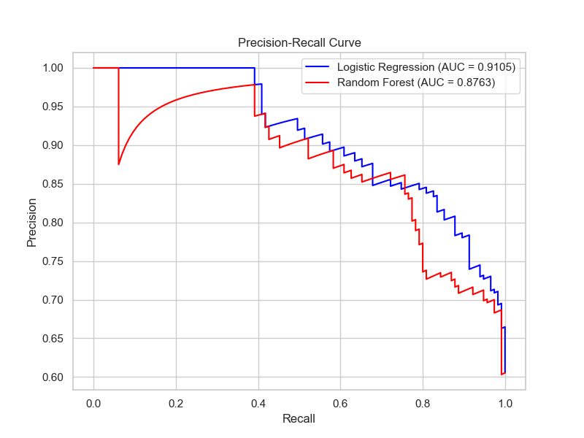
Outcomes
KPI- models are able to identify true high-traffic recipes while minimizing false positives. Both models performed better than the required value of 0.8 (80%).

Slide 9
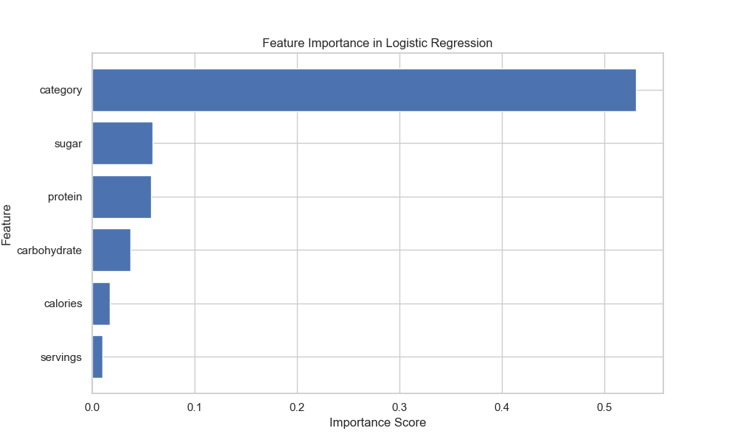
Outcomes
Logistic Regression model
Features:
Category
Sugar
Protein
Carbohydrate
Calories
servings

Slide 10
Recommendations
Test the model by comparing the traffic generated from using its predictions and random recipe choice.
Deploy the model using the web or mobile application
Analyze common features among high-traffic recipes to create new contents.
Stock-up on relevant ingredients linked to high-traffic recipes
Monitor performance regularly to adapt to changing user behavior
Re-train the model periodically with fresh data to maintain accuracy

